Slide 1

Large-Scale and Multi-Structured Databases Project Design WeFood
Cleto Pellegrino
Giovanni Ligato
Giuseppe Soriano

Slide 2
Application Highlights
This is a snapshot of the main features of the proposed application:
Upload recipes with ingredients and pictures;
Review other users’ recipes with stars and comments;
Follow other users to see their recipes;
Search for new recipes applying filters like ingredients;

Slide 3
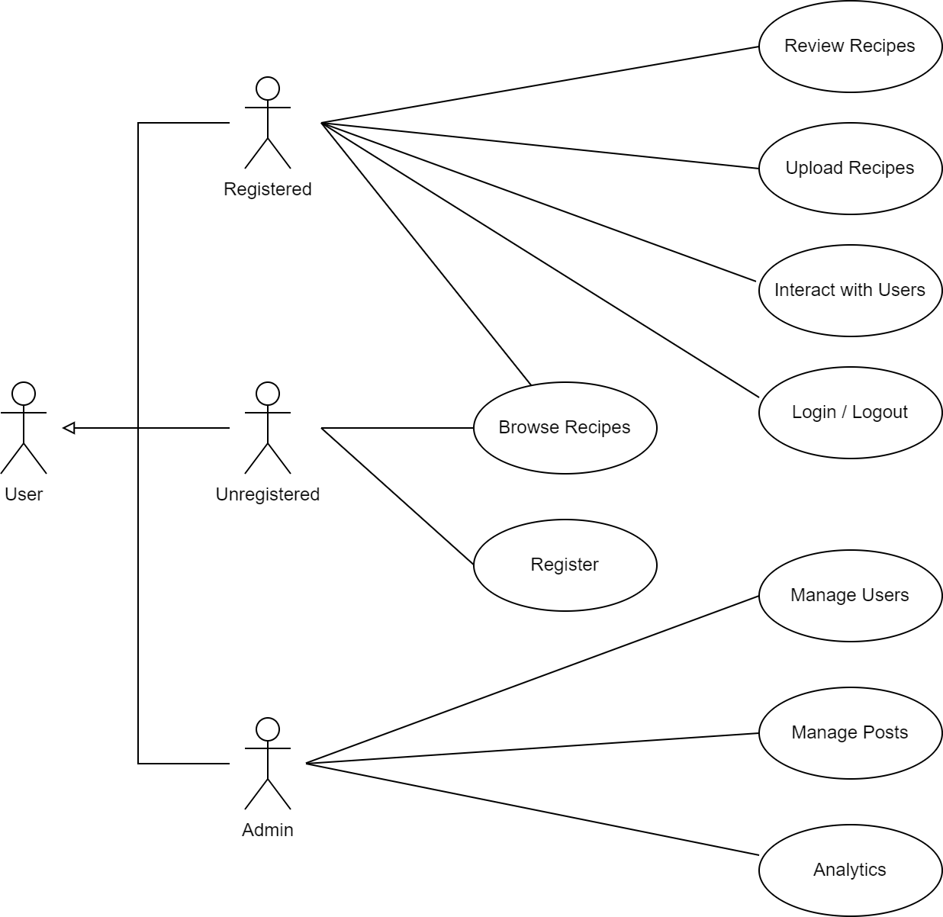
Actors and main supported functionalities
Here’s a simplified use case diagram.

Slide 4
Dataset Description
Source:
Calories.info - Calories in Food Items (per 100 grams)
Food.com - Recipes and Interactions
Food.com - Recipes and Reviews
Description: A group of datasets which contains recipes posted by users with their respective reviews and interactions done by other users. There is also a list of food with some info about calories.
Volume: Around 1 GB. Specifically: 2225 food items; 180K+ recipes and 700K+ recipe reviews; over 500,000 recipes and 1,400,000 reviews.
Variety: Calories.info and Food.com
Velocity/Variability: N/A

Slide 5
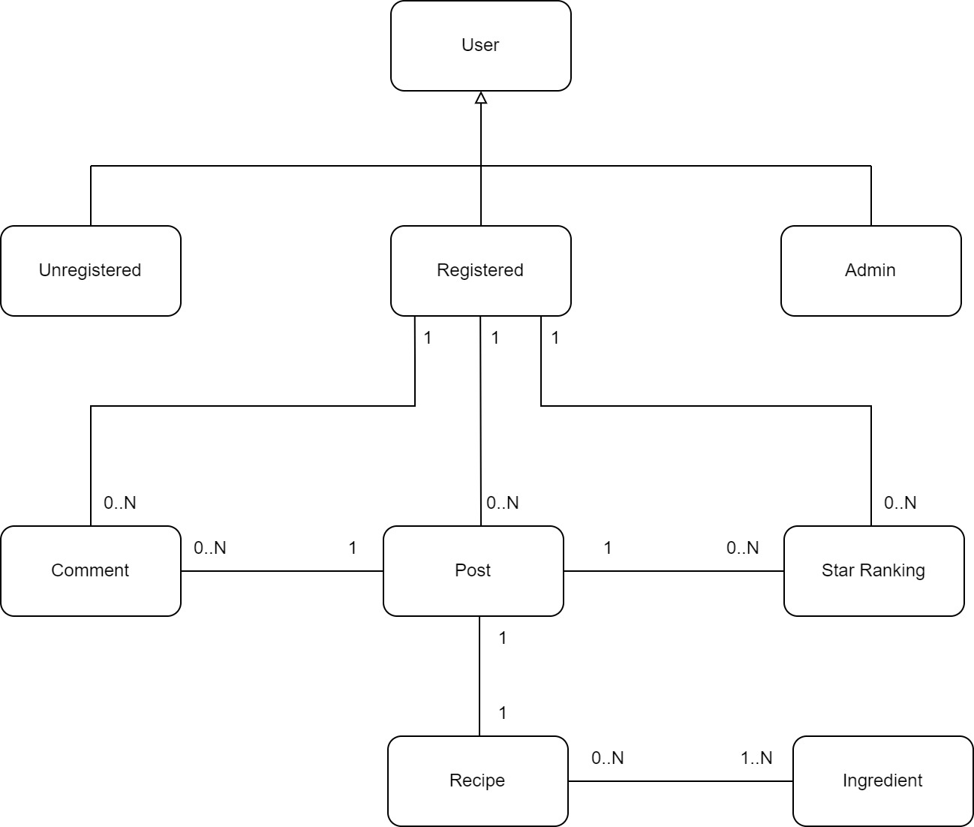
Preliminary UML Class Diagram

Slide 6
Requirements and Entities handled by Document DB
Requirements:
Analyze most/less active users on the Social Network based on how many posts they made recently (e.g. in the last 48 hours).
Analyze best posts (recipes) based on the average star ranking, given a specific set of ingredients.
Discover recipes with the lowest/highest calorie content while featuring the greatest variety of ingredients.
Average amount of grams of ingredients used in equal set of ingredients.
Allow users to look for new recipes filtering by the ingredients.
Find top users based on their number of actions (ranking or comments) on other users’ posts.
Find users filtering by different settings defined by the admin.
Entities:
User
Post
Recipe
Ingredient
Comment
Star Ranking

Slide 7
Requirements and Entities handled by Key-Value DB

Slide 8
Requirements and Entities handled by Graph DB
Entities:
User
Ingredient
Requirements:
New friend suggestions based on common friends.
Suggesting most popular combinations of ingredients.
Suggest new set of ingredients based on friends’ usage.
Find the users that have used the greatest number of ingredients.
Retrieve influencers (most followed users).

Slide 9






Software Architecture Preliminary Idea
Here are the frameworks and tools that the group would like to use (programming languages, DBMSs, etc..)

